Slide 1
Genetics Bootcamp: CRISPR screens in mammalian cells
Jan 9, 2023

Slide 2
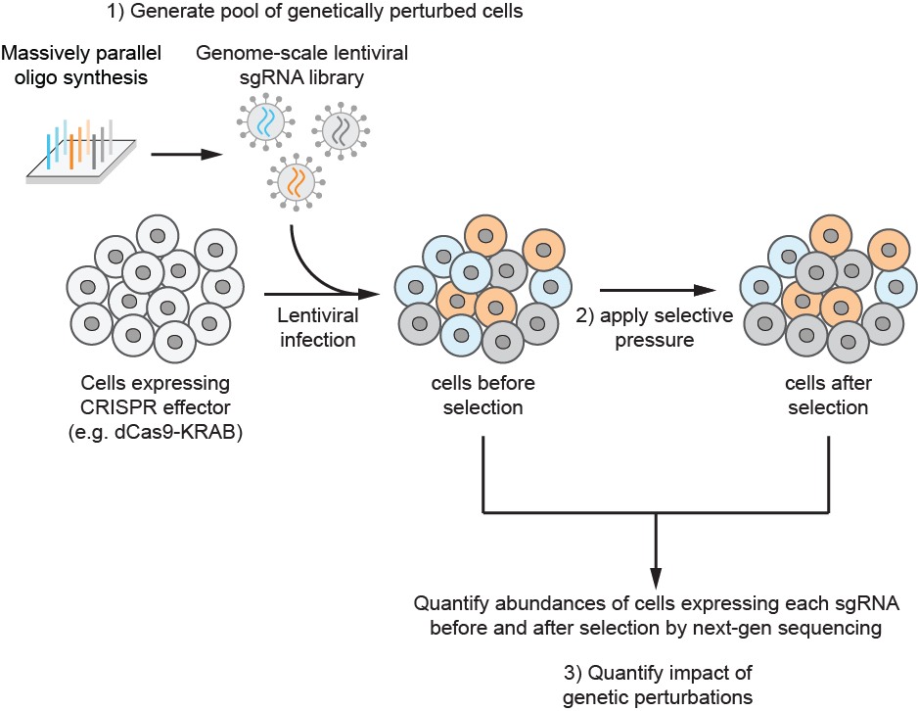
Components of a screen
Cells expressing CRISPR effector
CRISPR cutting, CRISPRi, CRISPRa

Slide 3
Components of a screen
Cells expressing CRISPR effector
sgRNA library

Slide 4
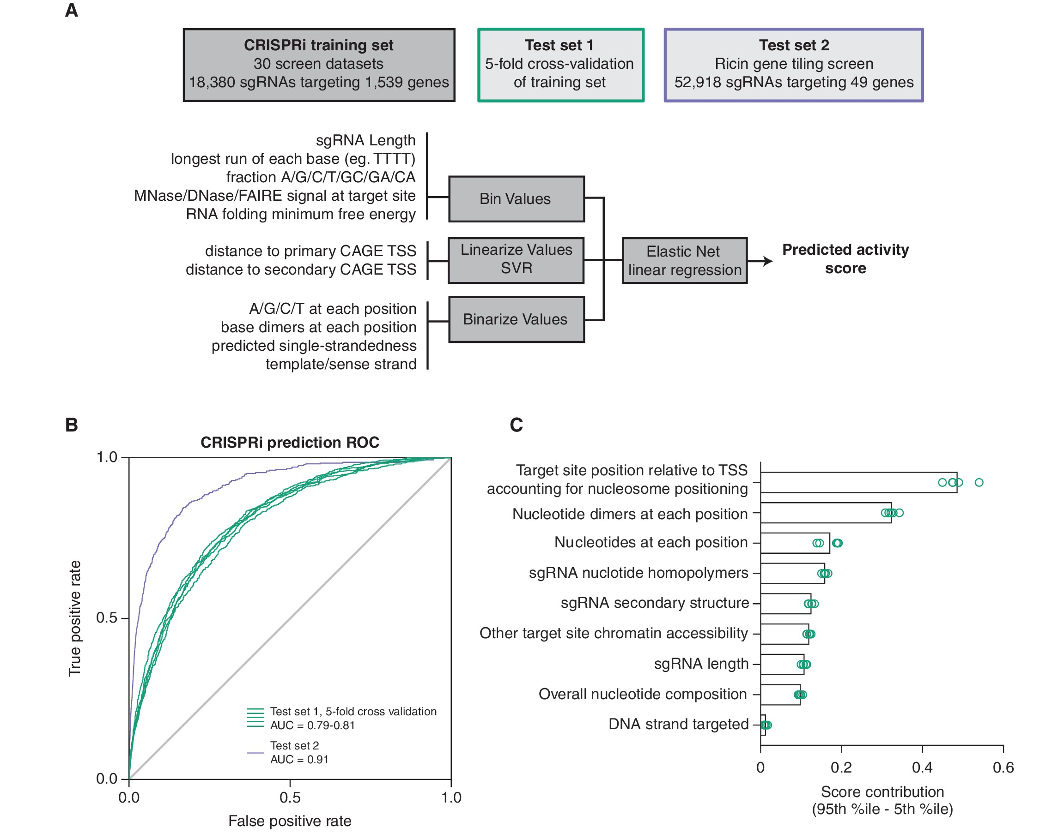
Components of a screen
Finding rules for active sgRNA design is an open-area of research
Data from: Horlbeck et al., eLife 2016 e19760

Slide 5

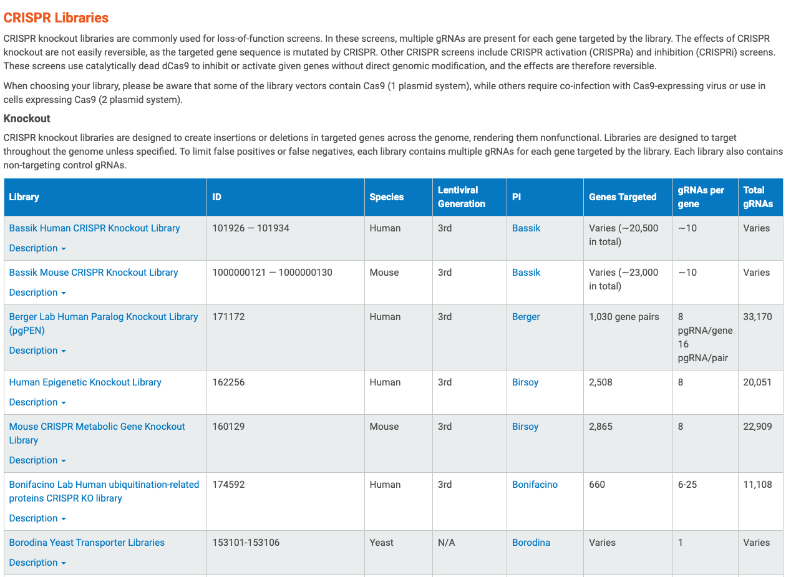
Components of a screen
Libraries exist for many common research organisms

Slide 6
Components of a screen
Cells expressing CRISPR effector
sgRNA library
Selective pressure
Growth? Drug Sensitivity? FACS reporter?

Slide 7
Genome-wide library or sublibrary?
key consideration is coverage, i.e. how many cells are maintained per sgRNA. We usually aim for 1000x to ensure robust results.
This is a lot!
# genes
20,000
# sgRNAs per gene
10
# cells per sgRNA
1,000
# cells in the screen
200 Million
with improved protocols, we can reduce coverage to 500x in many instances, with minimal decrease in signal
if you can create a list of relevant genes for a question, using sublibraries with sgRNAs targeting only these genes can reduce workload and enable screens of many conditions in parallel

Slide 8
Components of a screen
Cells expressing CRISPR effector
sgRNA library
Selective pressure

Slide 9
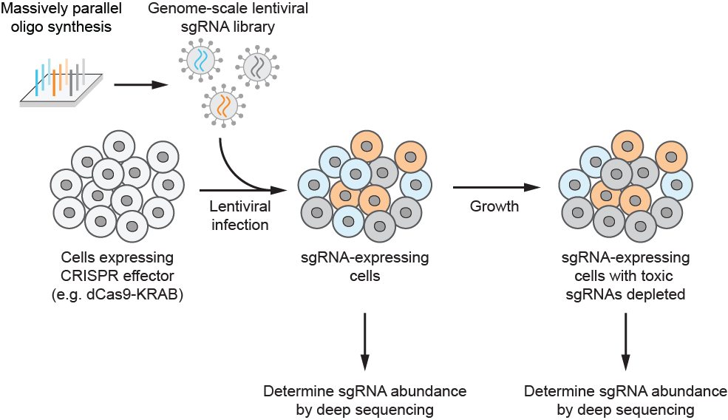
Library prep
Extract genomic DNA
U6 promoter
sgRNA
constant region
other vector elements
U6 promoter
sgRNA
constant region
other vector elements
U6 promoter
sgRNA
constant region
other vector elements
PCR amplify sgRNA cassettes and
append Illumina adapters
Illumina sequencing
(depth = ~0.7-1x screen coverage)
Critical: genomic DNA extraction and PCR need to be efficient to maintain representation

Slide 10
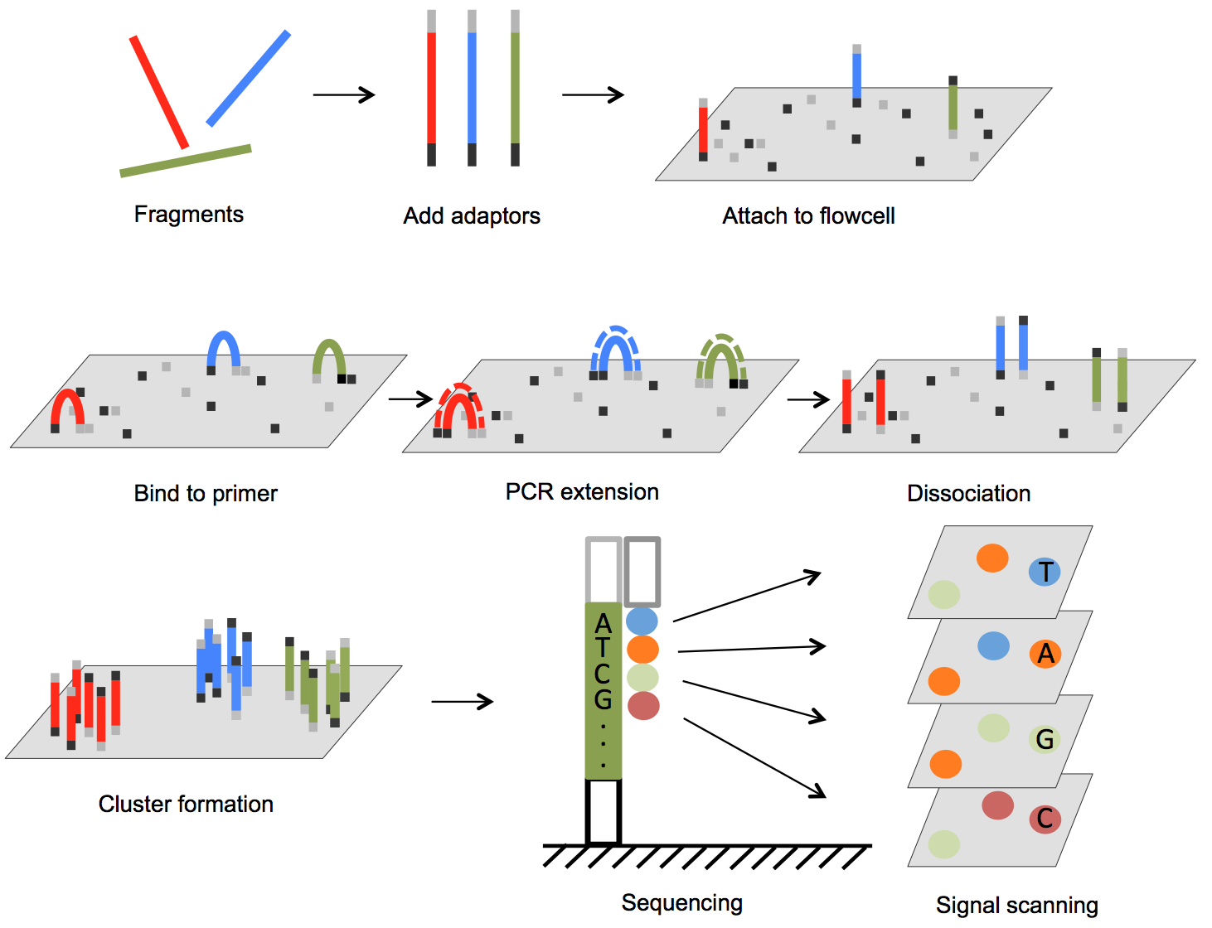
Illumina Sequencing Technology

Slide 11
Data Processing
Sample data can be found at:
github.com/nolanmaier/2023_GeneticsBootcamp

Slide 12
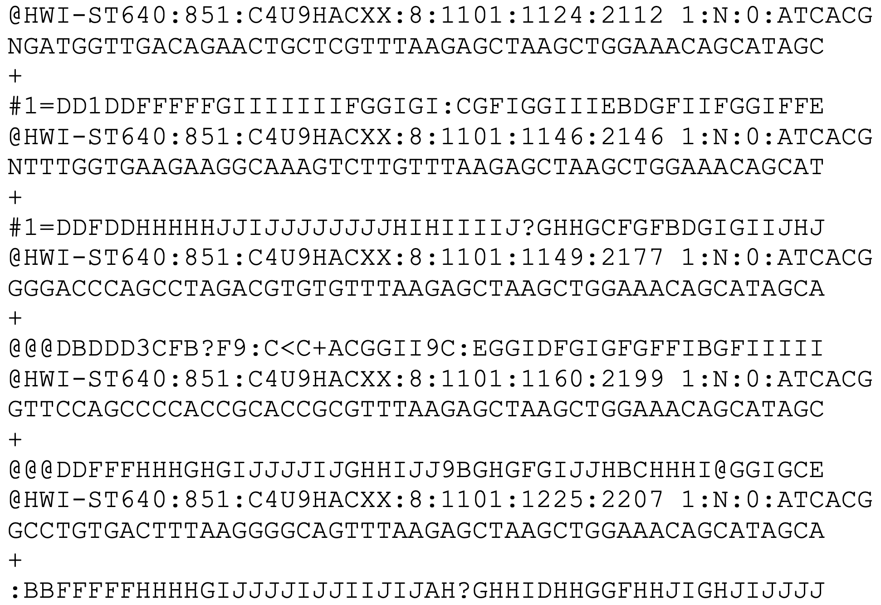
Data Processing Step 1: Convert sequence data to sgRNA counts
Open sample_illumina_data.fastq using a text editor
One entry = one read = one molecule in library
Line 1: sequence id
Line 2: base calls
Line 3: separator
Line 4: quality scores

Slide 13
Data Processing Step 1: Convert sequence data to sgRNA counts
Sequence id
Contents vary by sequencer and software
Usually contains information about the instrument, flow cell, cluster location, and demultiplexing information
Example format for Illumina sequencers
@<instrument>:<run number>:<flowcell ID>:<lane>:<tile>:<x-pos>:<y-pos>:<UMI> <read>:<is filtered>:<control number>:<index>

Slide 14
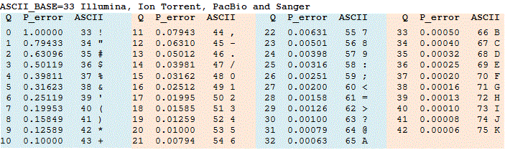
Data Processing Step 1: Convert sequence data to sgRNA counts
Quality scores
ASCII encoded
estimated probability of error

Slide 15
Data Processing Step 1: Convert sequence data to sgRNA counts
U6 promoter
sgRNA
constant region
other vector elements
All sgRNA sequences in sample are known
Use lookup table to find the matching sgRNA ID and gene

Slide 16
Data Processing Step 1: Convert sequence data to sgRNA counts
Try it yourself!
What sgRNAs do the first 5 reads in the FastQ file correspond to?
Use hCRISPRiv2_sgRNA_list.xlsx as your lookup table

Slide 17
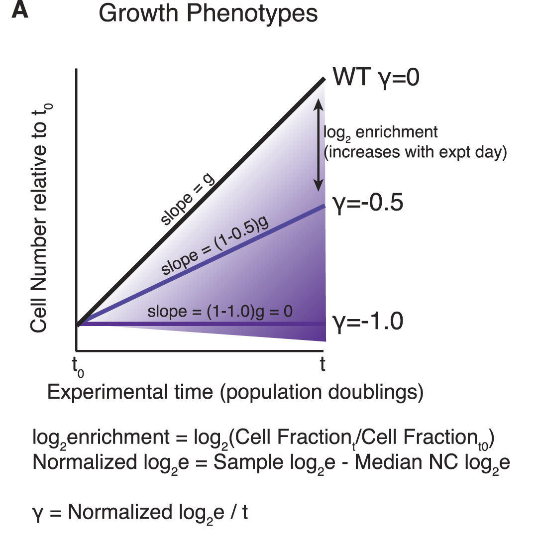
Data Processing Step 2: Calculate sgRNA and gene level phenotypes
sgRNA phenotype score
counts endpoint
sgRNA phenotype = log₂( )
counts start

Slide 18
Data Processing Step 2: Calculate sgRNA and gene level phenotypes
sgRNA phenotype score
counts endpoint
sgRNA phenotype = log₂( )
counts start
Try it yourself!
What are the phenotype scores of the three sgRNAs below?
start
endpoint
sgGeneA GGGCGGCTAGAAGGTGACCG 500
sgGeneB GCTGTCCAGGAGGGGCGTGT 750
sgGeneC GTGCACACGGCAGTAGAAAA 800
sgGeneA GGGCGGCTAGAAGGTGACCG 100
sgGeneB GCTGTCCAGGAGGGGCGTGT 750
sgGeneC GTGCACACGGCAGTAGAAAA 900

Slide 19
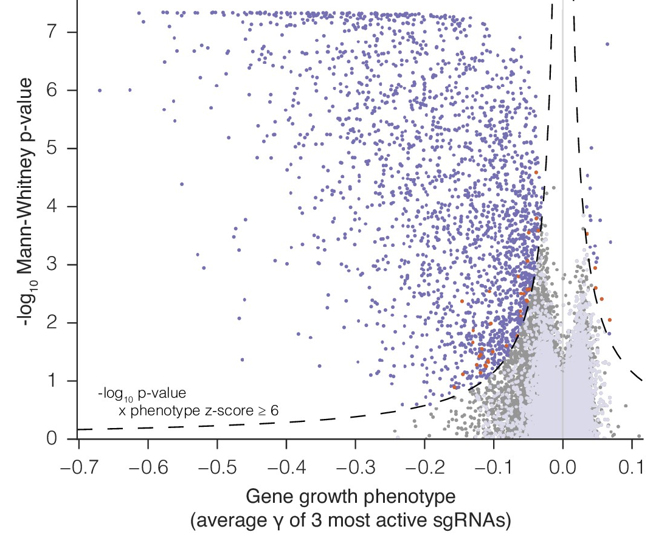
Data Processing Step 2: Calculate sgRNA and gene level phenotypes
gene phenotype score = average of 3 strongest sgRNAs
Mann-Whitney p-value = comparison of gene-specific sgRNA phenotype
vs non-targeting control sgRNA

Slide 20
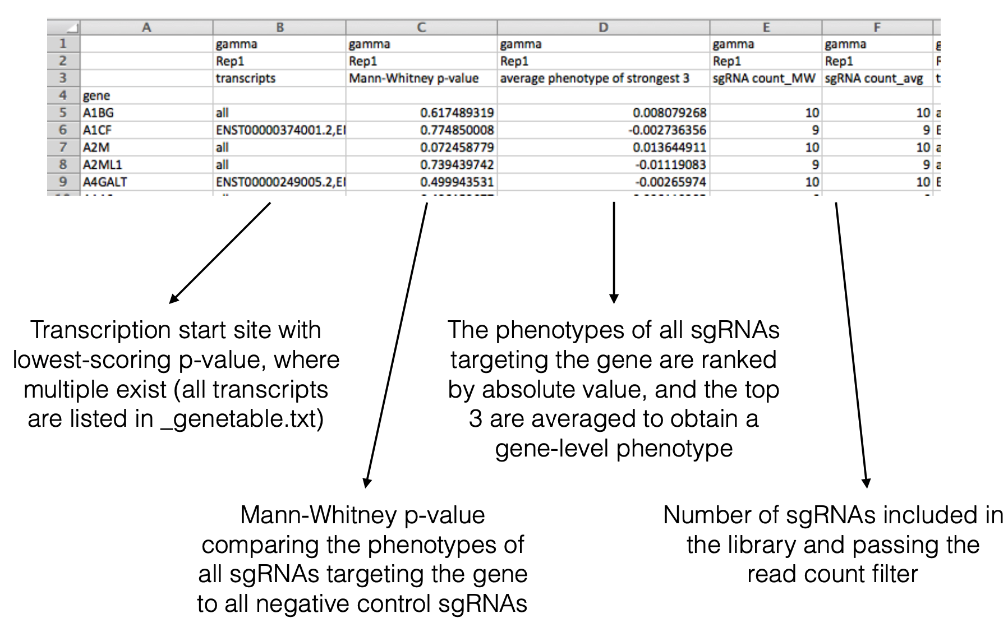
Data Processing Step 2: Calculate sgRNA and gene level phenotypes
Open screendata_growth.csv

Slide 21
Data Processing
No one actually does this by hand.
Many automated scripts exist for processing sgRNA count data.
Example python scripts can be found at:
github.com/mhorlbeck/ScreenProcessing

Slide 22
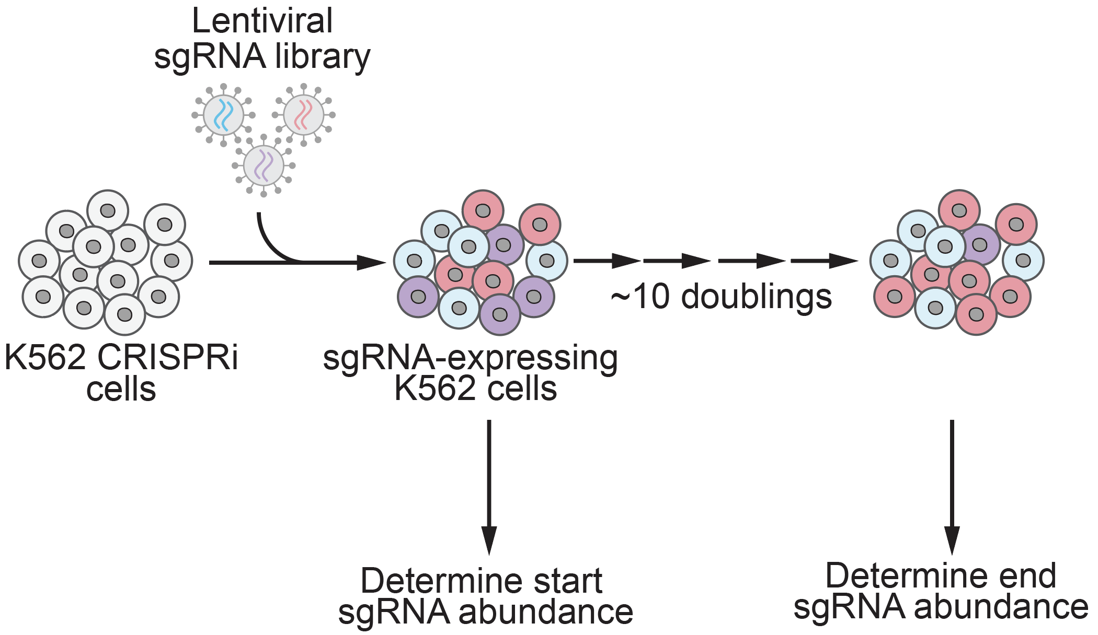
Data Exploration Part 1: Growth screen
Data from: Horlbeck et al., eLife 2016 e19760

Slide 23
Data Exploration Part 1: Growth screen
Try it yourself!
Open the CRISPR_screen_analysis.ipynb Jupyter notebook
There is a Binder link at the bottom of the Github repo:
github.com/nolanmaier/2023_GeneticsBootcamp

Slide 24
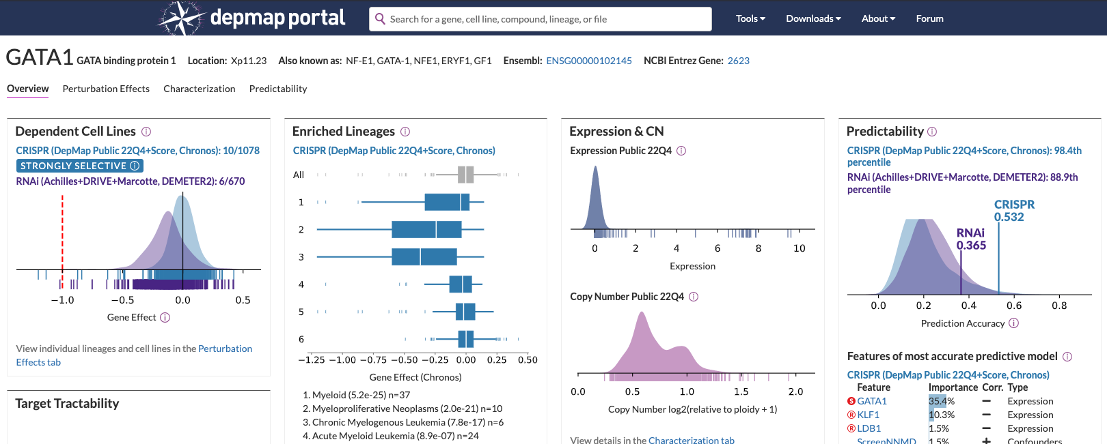
Data Exploration Part 1: Growth screen
Main Takeaways:
Essential genes (e.g. ribosomes) are major hits in growth screens
Comparing essential genes across cell lines can reveal cell-type specific essential genes

Slide 25
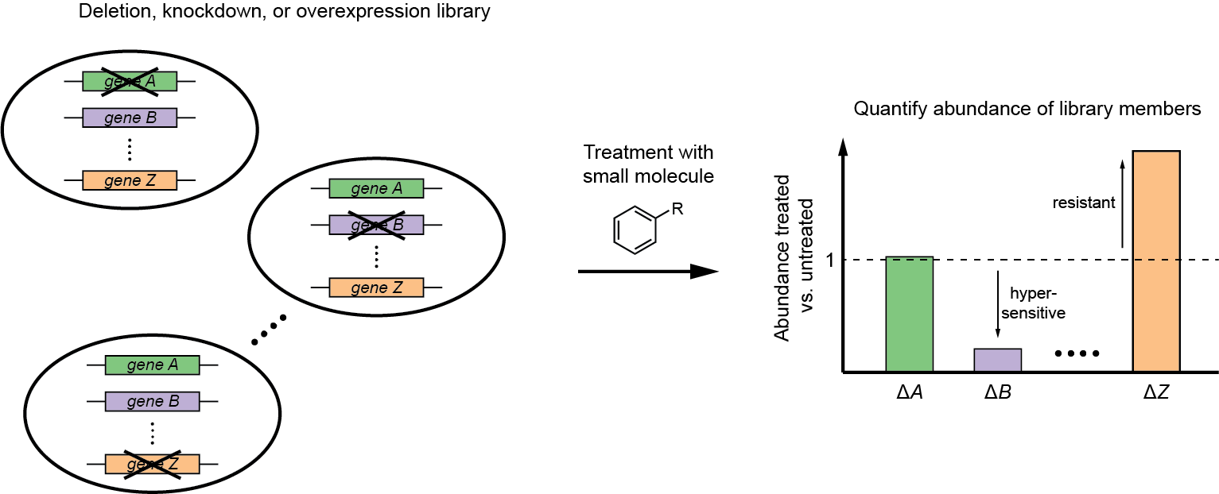
Data Exploration Part 2: Chemical-genetic screen
Chemical-genetic screening = systematic measurements of drug sensitivity of strains with perturbed gene expression (e.g. deletion or overexpression)
putative target
Giaever et al., Nat. Genet. 1999, 21, 647; Lum et al., Cell 2004, 116, 121; and more

Slide 26
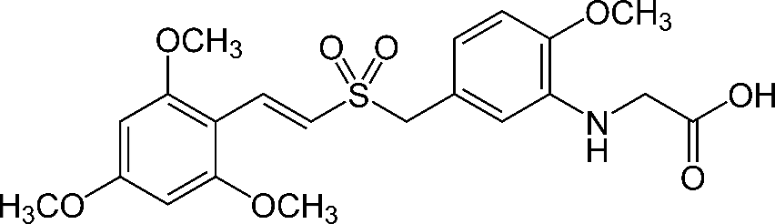
Data Exploration Part 2: Chemical-genetic screen
Rigosertib
(Estybon,
ON 01910.Na)
first reported in 2005, kills many types of cancer cell lines
causes G2/M arrest, apoptosis
was in phase III clinical trials for myelodysplastic syndrome and other cancers
but molecular target and mechanism of action unclear
proposed to inhibit polo-like kinase 1 (PLK1), PI3 kinase, or Ras signaling, but claims are controversial
Gumireddy et al., Cancer Cell 2005, 7, 275; Athuluri-Divakar et al., Cell 2016, 165, 643

Slide 27
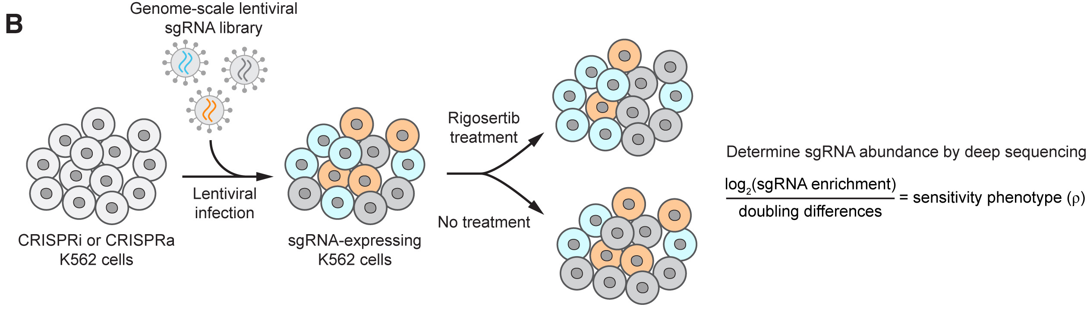
Data Exploration Part 2: Chemical-genetic screen
Data from: Jost & Chen et al., Molecular Cell 2017 68:1

Slide 28
Data Exploration Part 2: Chemical-genetic screen
Try it yourself!
Open the CRISPR_screen_analysis.ipynb Jupyter notebook
There is a Binder link at the bottom of the Github repo:
github.com/nolanmaier/2023_GeneticsBootcamp

Slide 29
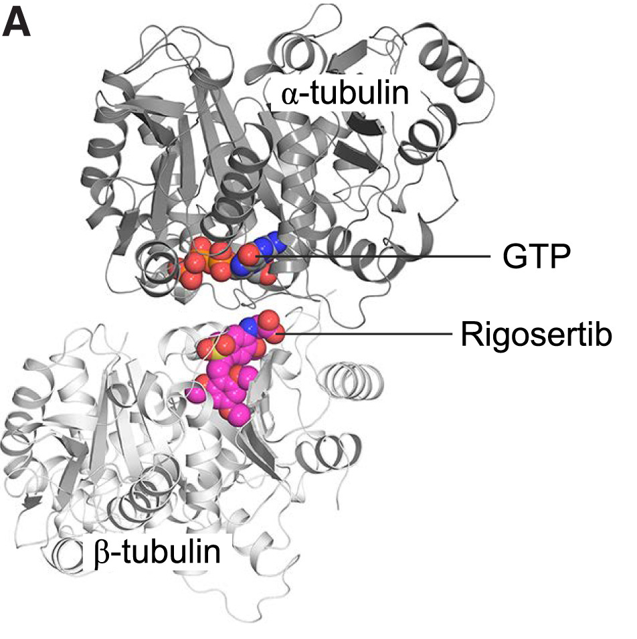
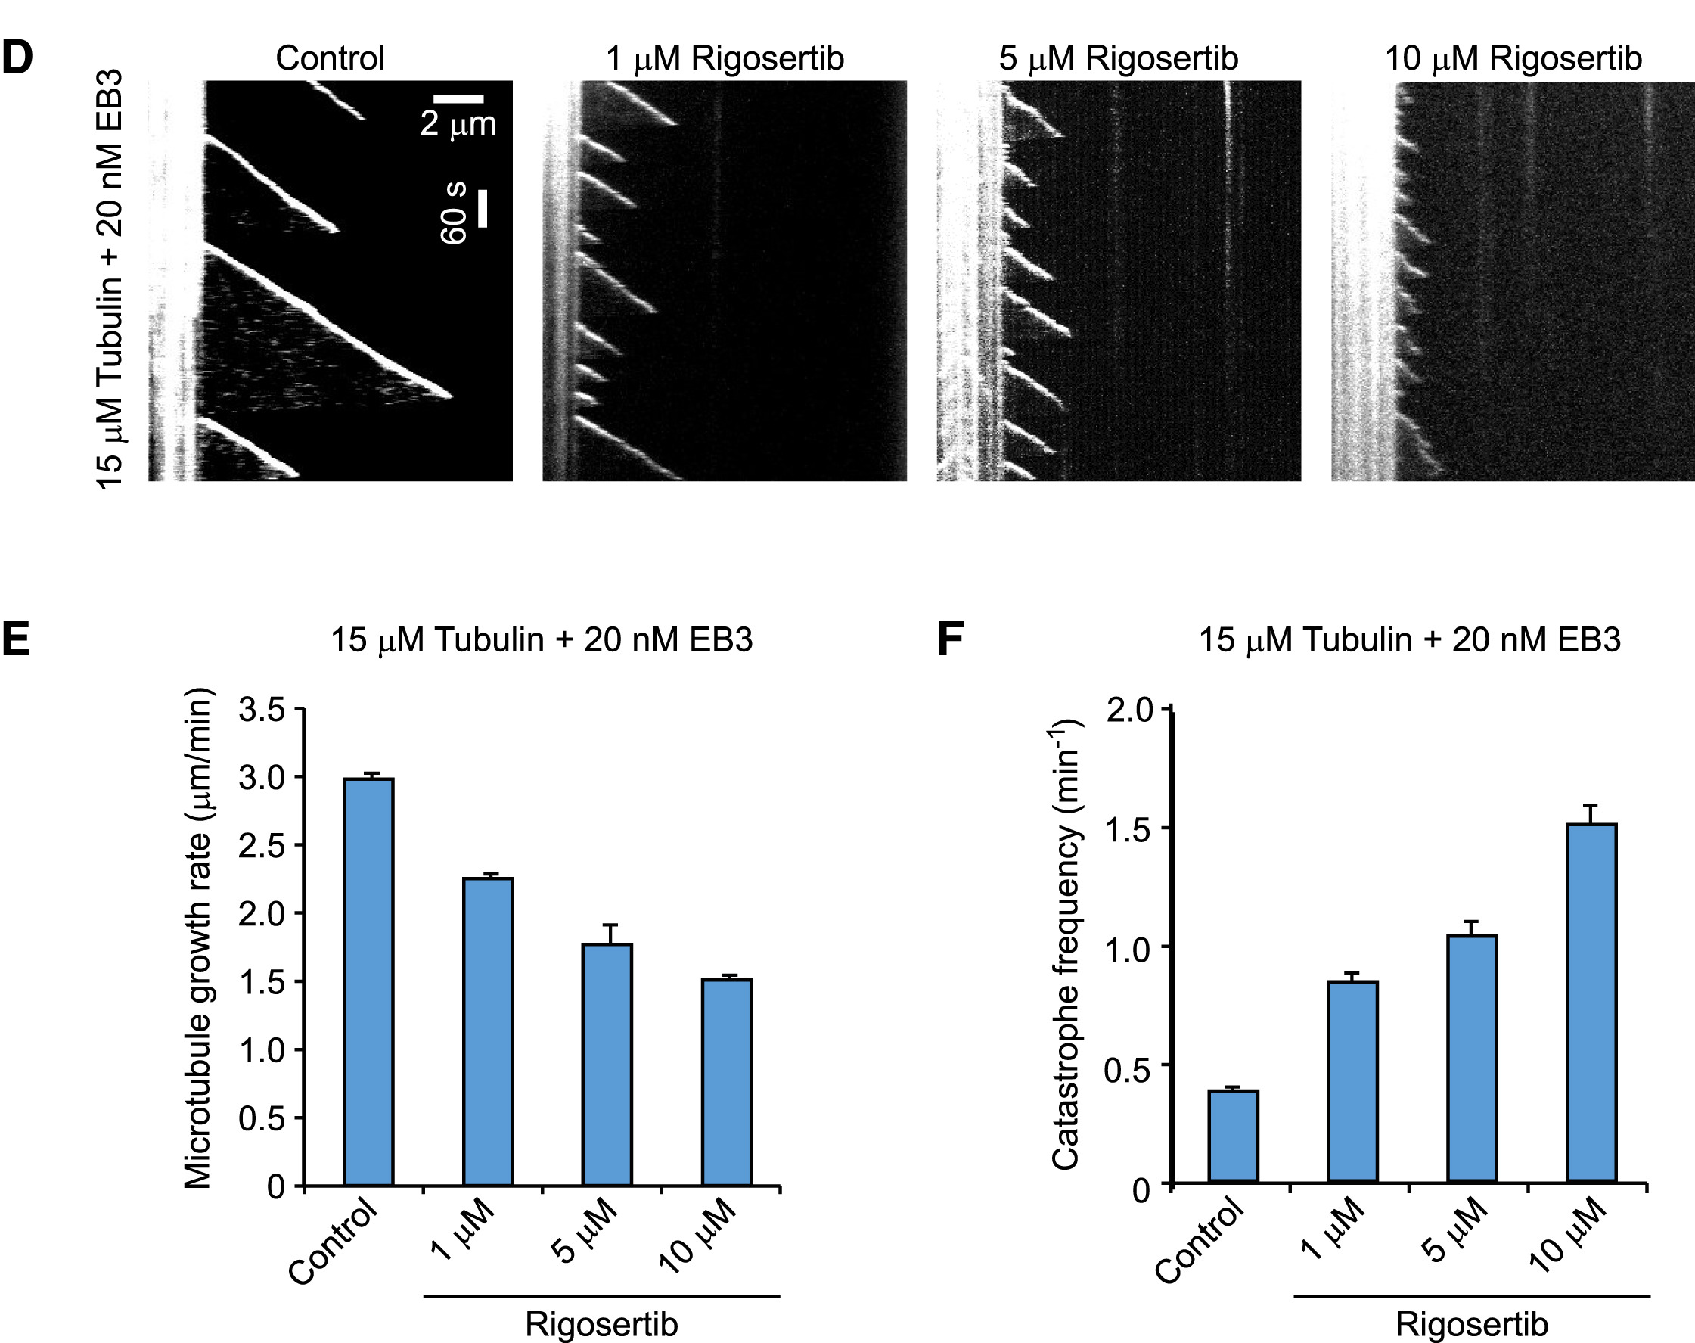
Validation: Rigosertib binds tubulin and affects microtubule dynamics
Data Exploration Part 2: Chemical-genetic screen

Slide 30
Data Exploration Part 2: Chemical-genetic screen
Main Takeaways:
Genetic screens are hypothesis generators
Layering data from multiple screens can narrow down hypotheses
Validation is always necessary to address a particular hypothesis

